Slide 1
The future of blockchain platforms

Slide 3
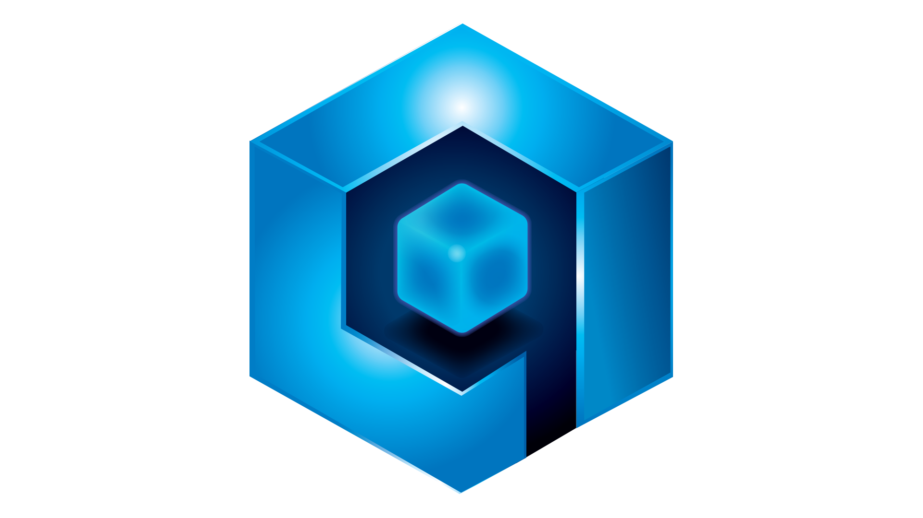
Qortal Features Overview

Slide 4
Why Qortal?
Qortal is a unique decentralized blockchain project focused on regaining control of our digital lives.
Qortal is an unhackable, unregulated infrastructure that has absolutely no centralized aspects, no censorship, no KYC/AML, no exceptions.
Individuals are in complete control of wallets, trades, communications, web/data hosting, application hosting, and more!
We do not MINE, we MINT! We do NOT compete to sign blocks - every minter earns a portion of each block reward with each block they help process.
Anyone can take part in earning block rewards for running a node and supporting the network on an average computer or a Raspberry Pi.

Slide 5
Qortal’s Mission Statement
The Qortal Network is bringing back individual sovereignty to a worldwide economy. Qortal will:
Rebuild the Internet so it is unhackable and censorship-free.
Provide a viable alternative to the devastation caused by exchange hacks and thefts.
Build a new worldwide economic system based on honesty, transparency, and democracy in a trustless fashion.
Implement a true democratic system with voting where the individual’s influence is weighted based on their individual contribution.
Establish a fair system with room for everyone to earn their place in the Qortal Network!

Slide 6
The Qortal Credo
We the People of the Qortal Blockchain Project (‘Qortians’), in order to form a more perfect democratic system to benefit every interested person, establish a platform to decentralize from conventional control, build a network for true freedom, and come together as one for the common good of the people worldwide. There are no ‘borders’ in Qortal. This is our Credo (a guideline to what the people of the world can expect from the Qortal Project).

Slide 7
The Qortal Credo: Section 1
We will structure a platform that puts the power back into the people’s hands with a fair system for all and an on-chain group with group-approved transactions that allow automatic updates of the chain.
Qortal will not infringe upon your right to free speech, free trade, right to information, nor right to build a shared future together. All major decisions on the platform will be made via voting by every leveled account. Admins of their sub-communities will be empowered to censor and manage their content in a similar fashion to ‘admin rights’ of any other system.
Individuals will be empowered to navigate the new Internet on Qortal’s infrastructure and decide for themselves what content they wish to see or not. Qortal’s DevTeam will not be empowered to censor content or users by any means!
The codebase and only the codebase is what governs.

Slide 8
The Qortal Credo: Section 2
Qortal will have its own decentralized trade portal that features true peer-to-peer transactions which provides true cross-chain trades without the need for a middle man as that has been historically proven to be flawed.
Qortal will have its own decentralized hosting service for websites, blogs, data storage, social media, and encrypted communication.
Qortal will have its own decentralized mesh network and satellite technology that encrypts data and ensures privacy (this can only happen once the network has enough reach for the mesh to function properly) .
Qortal will provide infrastructure for virtually any third-party ethical public or private project to be built utilizing the blockchain for security, authentication, and take part in a new economic model within the Qortal Network.

Slide 9
The Qortal Credo: Section 3
Qortal will never be empowered to censor nor force a political agenda upon its people.
The argument for the DevTeam having a limited power of governance over censorship has been discussed, but is impossible due to the nature of blockchains.
Any modification of any part of the blockchain retroactively invalidates the entire chain. Therefore, ‘removal’ of accounts or even the smallest transaction is impossible. As we have seen in the current world with censorship from big tech and political agendas, censorship simply doesn’t work overall.
Qortal will never have any sort of censorship oversight from the DevTeam level! It is up to the Group admins and individuals themselves to decide what content they wish to see and engage.

Slide 10
The Qortal Credo: Section 4
Qortal will enact a system where the Voting by leveled users allows the project to be community-driven giving voted decisions priority. Voting influence will be weighted based on time and contribution; blocks minted will equate the voting influence of accounts.

Slide 11
The Qortal Credo: Section 5
Everyone within the Qortal Network is expected to engage and contribute in an ethical fashion. Qortal provides an opportunity for the world to come together, despite our differences. If we are all here with the genuine intent of furthering mankind and building a brighter future for all, then the project is destined to succeed and positively impact the world.
Qortal will put the power back into the People’s hands worldwide. United we stand or divided we fall. If we are going to reinvent the wheel, we must have patience, respect, and understanding between us all.
Finally, word of mouth is the most effective marketing tool for organic growth. Let’s all be messengers who pass the great message of the revolutionary Qortal Project onto the next messenger!

Slide 12
Qortal Overview
Qortal strives to provide a truly decentralized blockchain with a codebase written from scratch that will support a scalable infrastructure including revolutionary new concepts such as:
Websites, social media, blogs, and encrypted hosting.
Peer to peer (P2P) trade portal; also known as a truly decentralized exchange (DEX).
Local crypto wallets that eradicate the need for centralized services; the user is in complete control of their wallets.
State-of-the-art security with more efficient data storage and usage.
Infrastructure for virtually any public/private applications to be built securely.
Minting distribution system that provides fair block rewards for users.
Voting system where every minter can be involved in steering the direction of the project.
Leveled voting system that is driven by the user’s contribution, thus gaining block rewards.
Supporting hardware to provide router, node, wallet, and other blockchain solutions.
Mesh networking with satellite technology to provide decentralized service connections.

Slide 13
Problem
Blockchain technology has become widely accepted as a viable solution to providing anonymity, creating new currencies, introducing solutions to fair trade, improving security measures to combat the latest threats, and increasing operating system efficiencies to say the least. Although there are a lot of great ideas as to how blockchain technology can help mankind evolve into a future with high demands, we have yet to see a truly decentralized blockchain emerge which can provide all-in-one solutions to:
A system built by the people, for the people - to empower lives.
A place where free speech can thrive and data can be published without censorship.
A stable and scalable infrastructure for both public and private applications.
A real ‘DEX’ or decentralized exchange for asset trading (without a central authority).
A way for users to have complete control over their assets with better security.
A more secure and efficient way to store/access data.
A block rewards system that distributes coins fairly (without expensive hardware).
A voting system where the community’s voice is heard and determines the outcome.
Affordable hardware to support the chain and allow everyone to get involved.

Slide 14
Solution
Crypto enthusiasts as well as freedom fighters around the world can take part in the next best thing with blockchain technology which will provide solutions to all of the problems identified.
Qortal will provide the foundation and gateway for solutions to our biggest concerns when it comes to the Internet's infrastructure, how we make use of the Internet, and the decentralization of blockchain technology.
Qortal will be able to provide a more secure way for websites, blogs, social media, communication, peer-to-peer (P2P) asset exchanges, wallet/asset storage, cloud storage, internet service, and virtually any other aspect of the Internet to operate without a central authority if desired.
Both public and private applications can be built on the Qortal Network and the Crowetic team is currently leading the project’s development in addition to the development of hardware applications to support it.

Slide 15
Qortal Background Information

Slide 16
Qortal Background Information
The codebase for Qortal initially started as the QORA codebase. QORA had launched in 2014 and after the takeover in 2016 by the current development team, it was completely written. So why is Qortal not QORA? Unfortunately, there were a number of factors with QORA which made it less rewarding to pursue development opposed to the new Qortal. Factors such as a codebase that needed a complete rewrite and design as well as 10 billion pre-mined coins which devalued the project’s true worth (not to mention an unethical event where centralized exchanges lost QORA holder’s coin and a massive amount of coins remain ‘unavailable’). Qortal did not deserve to launch with such baggage.
After considering the flawed aspects of: 1) QORA, 2) Bitcoin today in comparison to the original white paper, and 3) the blockchain space at large, Qortal has and will continue to be carefully designed to provide the world with a 100% decentralized blockchain concept that improves the way we make use of the Internet and blockchain technology!

Slide 17
Qortal Background Information
Since Qortal is the rebirth of the original QORA project, the decision was made for the QORA community to have a fair transition into Qortal. This was accomplished in two ways:
First, those who held QORA coin, were able to “burn” their coin for a “credit” in QORT, prior to Qortal’s launch. Since Qortal was planned to launch with no pre-mine or airdrop, this meant that the only way to give QORA Burners this “credit” would have to be as a portion of the block reward. With consideration to the inflated amount of coin that the QORA chain had, the burn ratio was set to 250:1. This means that for every 250 QORA burned, the account holder would be credited 1 QORT. How it works is QORA Burners earn 20% of the block reward, and their individual reward out of that 20% is distributed proportionately. This means that the payout of QORT in each block reward is given based on the amount of QORA burned. For example, if a QORA Burner had a credit of 100 QORT, and another QORA Burner had a credit of 50 QORT, the block reward for the person with 100 QORT credit would receive twice the block reward as the person with the 50 QORT credit.

Slide 18
Qortal Background Information
Another important fact to know, is that QORA Burners do NOT have to be actively minting to earn their QORT reward. They are also able to be a minter, and earn rewards based on their account level. To earn those additional rewards, the QORA Burners have to be actively minting. Every other account type DOES have to be actively minting to earn their portion of the block reward (including Founders). We’ll explain the block rewards in further detail shortly.

Slide 19
Qortal Background Information
The second decision made for the community of QORA who are transitioning to Qortal, was for the “QORA Forgers”. The only account holders who would be able to sponsor others at Qortal’s launch would’ve been the Founders, which have the same limitation as any other sponsor-enabled account of 5 sponsorships at one time. With all things considered, QORA Forgers were given credit for the blocks minted during the specific period of time when they ran a node to support the QORA chain when it was largely abandoned. This was considered to be an act of dedication and most likely an indicator of good character.
QORA Forgers were given pre-leveled accounts and as a level 5 account, were sponsor-enabled which would help grow the network of minters at Qortal’s launch, rather than limiting that growth by the Founders alone.

Slide 20
Founding Team Hardships
No real funding
No pre-mine (ICO/IEO/airdrops).
No intellectual property for the conventional investor.
Limited developer resources
All of our developers are NOT full time and help in their free time.
Work is usually paid based on work completed, not prior.
All that we have to offer is QORT or other coins that are donated or sold from the DevFund.
Core is written in Java, UI is written mostly in JavaScript.
A codebase built from scratch with unexpected hurdles to overcome
Chain stability, scalability, and overall functionality.
Unethical gaming of the minting and sponsorship systems.
Unexpected bugs.

Slide 21
What We Have Now (June 2022)
Genesis block was launched on June 29th 2020.
Two years later, we have made it to Phase 3.
Phase 1: Network launch with minting, sponsoring, wallets, sending coin, and Q-Chat (blockchain-based messaging with P2P encryption).
Phase 2: Trade Portal launch with BTC, then LTC and DOGE (BTC trades were deactivated at one point but are now live again).
Phase 3: Qortal Data Network (QDN) launched with free public website and data hosting, there is a current limit of 500MB as we work towards greater scalability. Wallets and Trade Portal now support Ravencoin (RVN) and DigiByte (DGB)! UI now supports over 15 language versions (more will be added over time).

Slide 22
What We Will Have Soon
Q-Apps where anyone can build on-chain without approval (excluding asset issuance).
YouTube replacement.
GitHub replacement.
Easy website maker for QDN.
Voting System.
Minting & Sponsorship system modifications.
Additional currencies in Trade Portal (ARRR is nearing completion).
Lite nodes and a mobile app (all features excluding minting).
Further development of Q-Chat (Telegram type features).

Slide 23
What We Will Have In the Future
Privacy-focused features such as private transaction types and obscuring IP addresses. It's important to note that IP addresses do NOT show your home address or personal information to outsiders - so fear not, your privacy is paramount on Qortal.
Third-party minting projects with their own asset rewards.
Mesh networking for local nodes to communicate with each other.
Satellite bridging to bridge gaps between local mesh networks.
Complete sovereignty from the existing internet service provider (ISP) backbone.

Slide 24
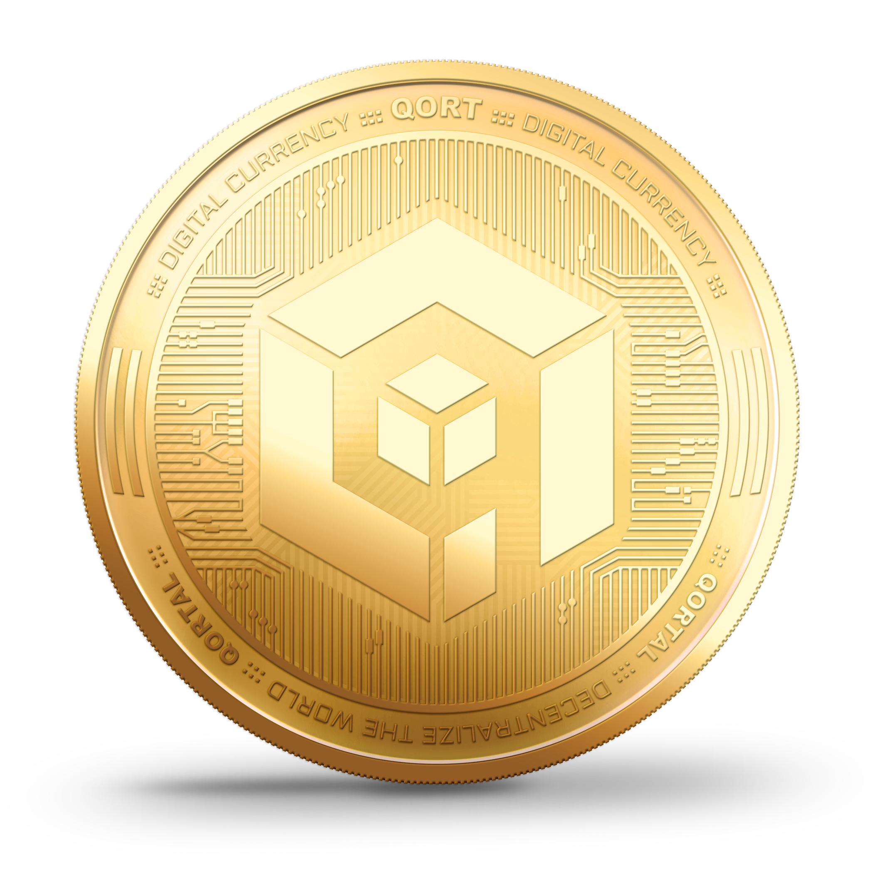
Qortal’s QORT Coin

Slide 25
Qortal’s QORT Coin
Qortal has its very own coin called QORT which powers on-chain functionality and can be used as a digital currency just as Bitcoin is a decentralized digital currency, without an intermediary like a bank. There is no intention of listing QORT on other exchanges as Qortal has its own exchange and more importantly, is meant to be used on-chain.
Qortal aims to create an alternative infrastructure for a new Internet where among many other aspects, an especially important feature will be the ability for e-commerce stores to host their sites on the Qortal Network and have the ability to accept QORT as a form of payment just as they will be able to with other cryptocurrencies we support. We will also create a jobs market board that can utilize QORT and the coins or tokens we support. You may ask, what is the difference between coins and tokens… the answer is, there are two types of crypto assets: coins and tokens.
Coins have their own blockchain, such as QORT, BTC, LTC, DOGE, RVN, and DGB (we support these particular coins now). Tokens on the other hand, run on another blockchain. For example, Ethereum has its own coin called ETH, while it also has ERC20 tokens which are projects built on its chain. The same will be possible on Qortal’s chain: ethical projects will be able to have their own minting system and token. We will explain this feature more later.

Slide 26
Qortal’s QORT Coin
QORT is used as the base pair for the Trade Portal with cross-chain trades. For example, for a BTC-LTC trade, the trade will actually be BTC-QORT-LTC. QORT can only be obtained by conducting a true cross-chain P2P trade within the Qortal Trade Portal (other than by minting). As everything we are building is 100% decentralized on-chain which means there is no vault like there are on centralized exchanges where you can immediately convert fiat or crypto. This means to conduct a true P2P trade, you will need to run your own node. Then, for example, you will send LTC to your Qortal LTC wallet, then buy a listed sell order within the Trade Portal.
QORT will be a great store of value for investors to consider as 1) the wallets are fully secure and 2) QORT will provide an increasing amount of intrinsic value as time goes on with the plethora of applicability (price of QORT will increase based on supply and demand)!

Slide 27
Qortal’s QORT Coin
There is no cap on QORT production like Bitcoin has with its 21 million. Where Bitcoin has a cap and has its fees, Qortal has no cap on its coin production and aims to be fee-less. This is the trade-off.
Approximately every ‘6 months’ (based on a 60 second block time which is slightly higher) there is a decrease in block reward from its start at 5 QORT, by .25, until 2 QORT is the reward. Thereafter, a vote can be made for an increase or decrease of 0.25 to 1 QORT difference per block via vote, however, this type of vote can only take place one time per ‘year’ (in blocks). For example, if the current block reward was 3 QORT, the vote could only be: 2, 2.25, 2.5, 2.75, 3, 3.25, 3.5, 3.75 & 4 QORT. (Only up to a 1 QORT difference up or down or any 0.25 increment between.)
Block reward can only be voted to as low as 1 QORT per block, or as high as 5 QORT per block. These are the minimum and maximum block reward range Qortal will ever potentially see. We are currently at 4.25 QORT per block.

Slide 28
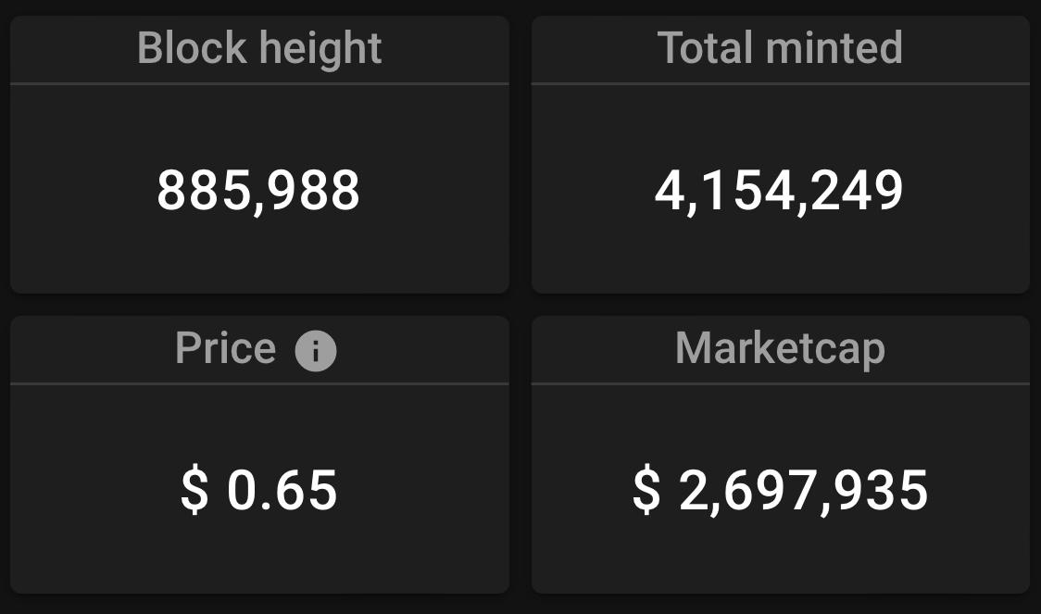
Qortal’s QORT Coin
Here is a screenshot from www.exqlorer.com (that is, e-x-q-l-o-r-e-r-dot-com) which displays blockchain data of Qortal. Here we can see on June 21st 2022 around 10:30 AM Pacific Standard Time, we had processed over 885k blocks since Genesis and we’ve minted over 4.1 million QORT. Next we see the ‘average price’ the Exqlorer displays based on the most recent 5 LTC trades in the Trade Portal which equates to $0.65 and based on these figures that gives us a current market cap of over $2.6 million which is extremely undervalued (and isn't an accurate measurement of QORT’s value based on LTC’s market).

Slide 29
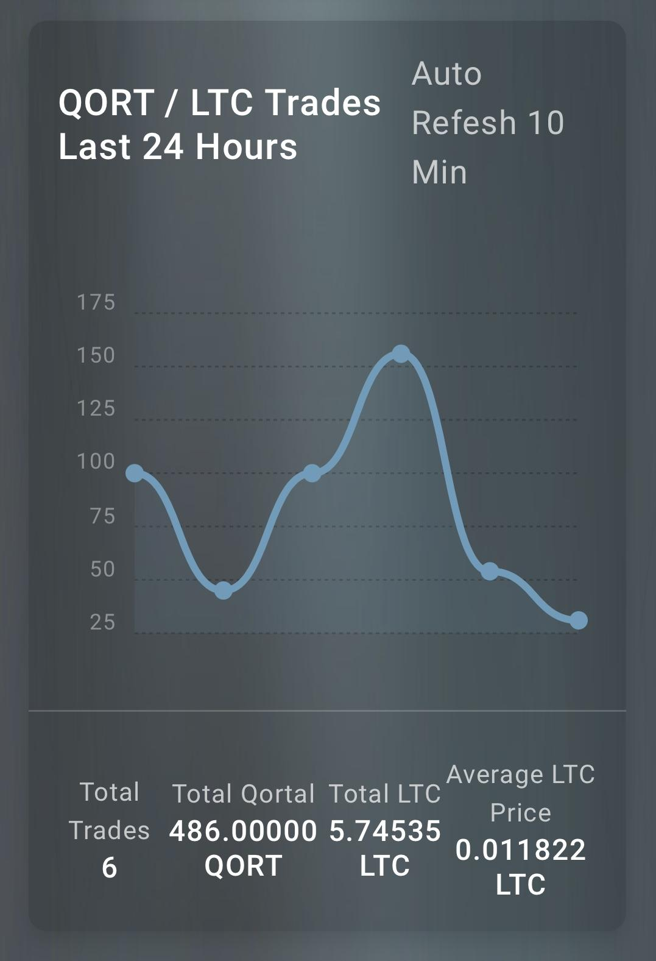
Qortal’s QORT Coin
Here is a screenshot from www.exqlorer.qortalnodes.live which is another explorer one of our devs made. Here we can see a more accurate QORT value which is based on direct trades between LTC and QORT (not QORT-LTC-USD based on LTC’s direct value to USD). The point being made here, is that QORT’s true value is directly between QORT-LTC or whatever market trades we’re looking at (BTC, DOGE, RVN, DGB, etc.) QORT value to USD is INDIRECT and based on a third-party coin’s direct value to USD. Make sense?

Slide 30
Qortal’s QORT Coin
Market caps are arguably not a fair indicator of a project’s potential. Market caps are more of a conventional investor’s tool that simply do not accurately apply in the crypto space. We are often asked what is the current price of QORT and that really depends on how we choose to calculate that price (which also affects the posted “market cap”). Price is always based on x number of recent trades. In the case of the Exqlorer, the price is an average based on the last 5 trades in the Trade Portal. Keep in mind this USD value is only based on LTC’s value to USD - NOT QORT TO USD! The real way to value QORT is the average trade value directly with other coin markets, such as QORT-LTC which is around 0.01-0.02 QORT per LTC.
We must remember that the Trade Portal has no sell walls so there isn’t a ‘set price’ and it’s really up to the sellers and buyers to decide what they think is worth trading. With that said, you be the judge of what QORT is really worth now, and what it will be. With respect to the on-chain applicability and real-world purpose, we feel the value is destined to increase substantially.

Slide 31
Block Rewards
The block rewards in Qortal are distributed to every online minter, regardless of the minter who actually signs the block. The rewards are based on the level of the minter and how many online minters are taking part in each block.
In other words, we all earn a portion of each block reward by simply running a node, and supporting the network (starting at account level 1 which requires sponsorship and prevents bot farms). Each tiered group of leveled accounts share a percentage of each block reward as explained in the next slide.

Slide 32
Block Rewards & Distribution
Levels 1 & 2 share 5%
Levels 3 & 4 share 10%
Levels 5 & 6 share 15%
Levels 7 & 8 share 20%
Levels 9 & 10 share 25%
QORA Burners share 20%
Founders share 5% plus leveled tiers that are not currently filled (which are tiers 7/8 & 9/10 at this time). This is essential for funding the network by empowering the Founders to reward contribution and drive development (coding, marketing, tech support, etc.)

Slide 33
Account Types
Founder - able to mint, sponsor, and have a weighted vote of a level 10 + blocks minted (until the first account reaches level 10).
DevTeam Admin - able to take part in the 60% approval among Admins to push updates.
Minter - able to mint, able to sponsor once reaching level 5, and have a weighted voted of blocks minted.
User - not sponsored, not minting, not able to vote, but can use all of the other features on-chain outside of minting/account leveling/sponsoring.
Soon to come:
Data Node - able to host data for others as cloud storage and charge a fee.
Data Supernode - same as a data node with much larger storage capacities.

Slide 34
Node Types
Full Nodes - store the entire blockchain database. A full node is the recommended node type for Minters, as they are meant to be the nodes that ‘power and support’ the network, and a full node is the best type of node to accomplish that.
Top-Only Nodes - store the entire blockchain database, but with a majority of the ‘unneeded’ information ‘pruned’ or ‘trimmed’ out. This gives the ability to run a minting node with much less overall storage space required.
Soon to come:
Lite Nodes - will not store any of the blockchain database, minting will not be possible, but will be able to communicate with full and top-only nodes to use all of the other features.
Data Nodes - data nodes and data super nodes for cloud storage solutions.
Notes:
Wait for g

Slide 35
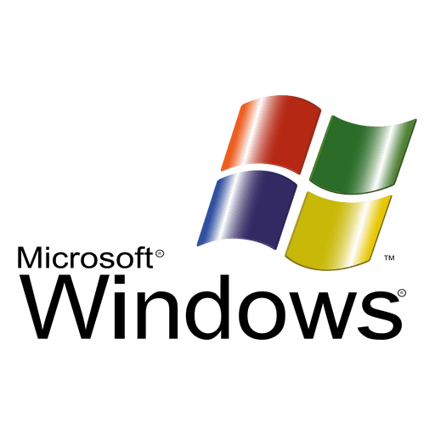
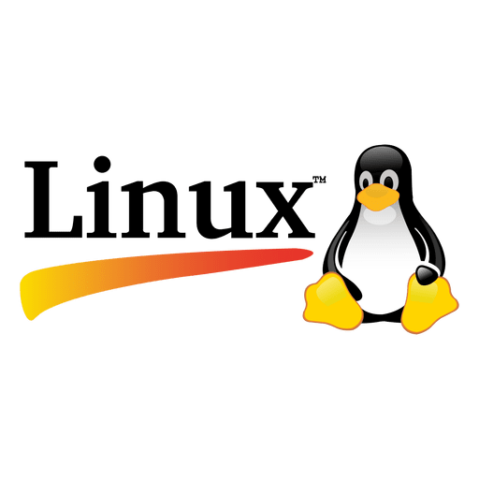
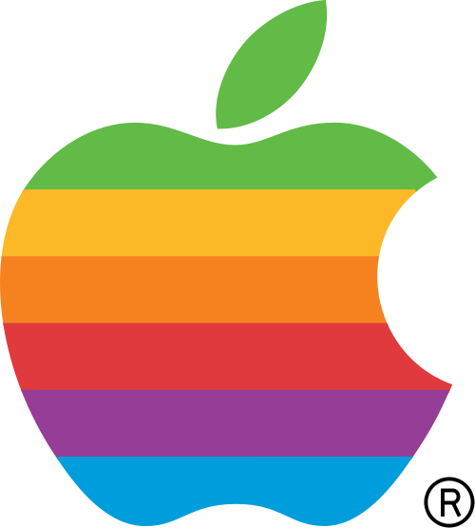
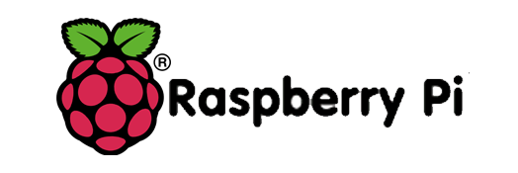
Supporting Hardware

Slide 36
Supporting Hardware
Qortal allows the average computer to operate as a full node, whether Linux, Windows, or Mac OS as well as a VPS. Simply download the core and UI, let it synchronize, let it run 24/7 to remain synchronized, and you can make use of all the features on-chain (excluding minting and voting - which simply requires introducing yourself to the community and obtaining sponsorship).
A cheaper and revolutionary concept has emerged: the QORTector - a Raspberry Pi 4 with several custom kernels to choose from which are built specifically for Qortal. These devices only draw 5w/5v of power (equivalent of a cell phone) and are an affordable, cost-effective dedicated minting machine option!
Everyone can build their own QORTector as there is never any intellectual property with official development for Qortal and it is always 100% open source!

Slide 37
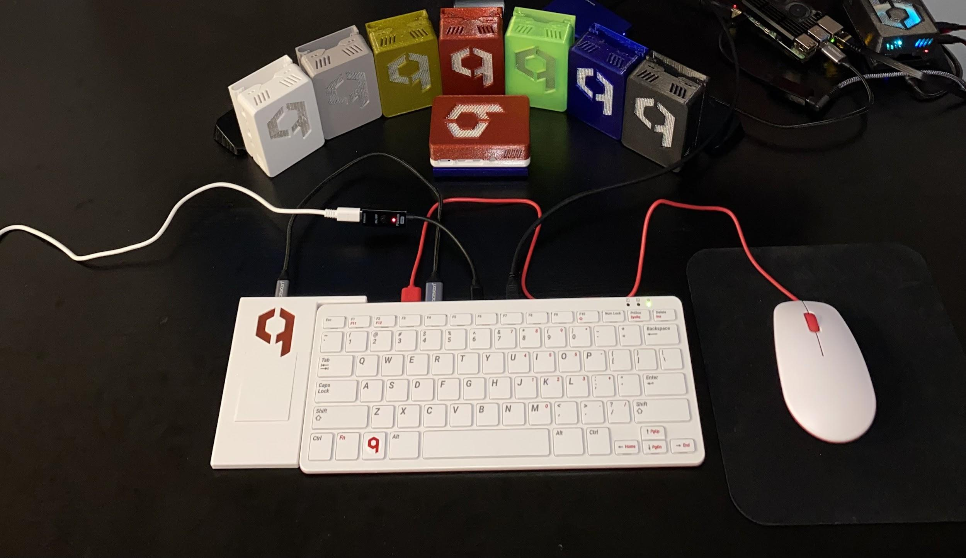

Slide 38
Crowetic Hardware Development (CHD) is a Nevada based company that three co-founders (Crowetic, G Factor, and Crowetic’s brother FDM Dynamics) formed to provide pre-built devices to those interested. CHD manufacturers custom cases for the hardware they sell with 3D printing and each device is individually tested prior to shipping. CHD also shares 20% of its profits with Qortal development as the whole idea of the company is to support the development of Qortal’s codebase and community. Please note: CHD ships worldwide!
CHD is simply a third-party service for the Qortal community who are interested in purchasing a pre-built device rather than hassle with building their own, or relying on their existing computer to run as a node 24/7. CHD is also opening a merchandise store with clothing, banners, flags, memorabilia coins, and more. Stay tuned!
Website: www.crowetic.com
5% off promo code: QORT5

Slide 39
What to expect later:
QORTable (USB drives)
Laptops
Mobile Phones
Solar & battery packages
Security-Focused Routers

Slide 40
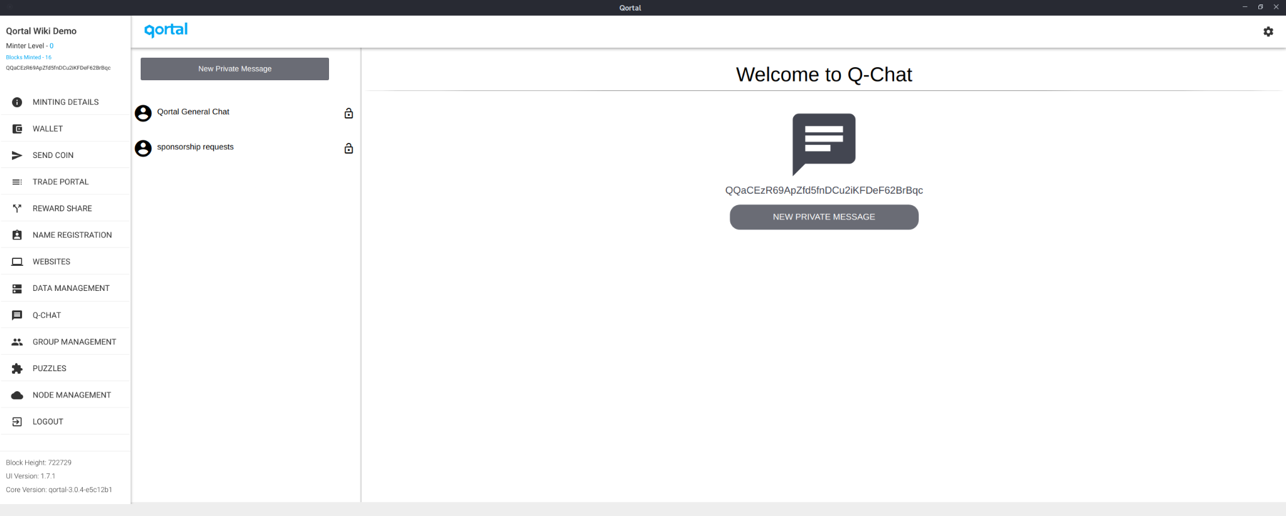
Q-Chat
Q-Chat is a blockchain-based messaging system that is censorship-free and will allow free trade of information without hindrance (excluding sub-community groups which may set their own rules and sanctions). It utilizes a custom transaction type on the Qortal Network, along with a custom memory-based Proof Of Work algorithm to send real-time messages within groups and via PM to users.

Slide 41
Q-Chat
Currently Q-Chat only allows for text messaging, but will soon have voice and video as well as the ability to replace apps like Telegram with image attachments, GIFs, etc. Peer to peer messages are fully encrypted!
Messages currently last for 24 hours to prevent chain bloating. These are actually stored in a ‘memory pool’ not in the actual blockchain ledger. As QDN is further developed, messages will be able to be pinned and be stored locally on the user’s node for longer periods of time (such as 30 days).
Q-Chat is intended to become a viable and secure alternative to centralized chat systems. With encrypted chat, users can feel confident that their communications are secure and their right to privacy is upheld. No longer will we have to use third-party systems where data is collected and used without our permission!

Slide 42
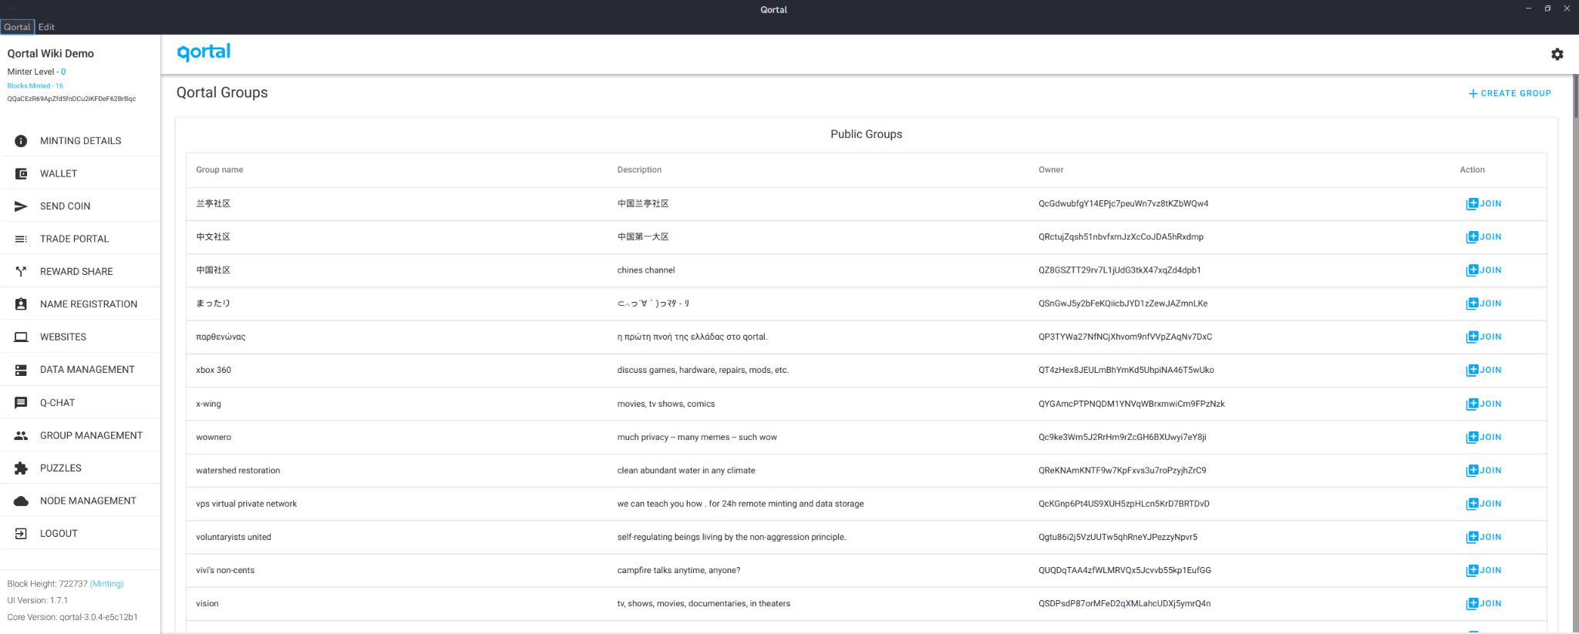
Q-Chat Groups
Everyone is able to make their own public or private group. Admins of their groups will be able to have complete control over their groups such as admins have over their self-created Facebook groups.

Slide 43
Q-Chat
Q-Chat hasn’t been fully developed yet, so a lot of these features are not present in the user interface, but rest assured they will be in due time!
Creating or joining a group currently costs 0.001 QORT which is the standard transaction fee on-chain. Messages are slowed for users with no QORT balance in their wallet as a means to combat spam/robots. Simply buy a little QORT in the Trade Portal or ask a community member to send you coin, and enjoy full speed messaging.
Once you have QORT in your wallet, you can also register a unique name for your account if you'd like, which will display in Q-Chat rather than your QORT address. Your registered name can also be used to send direct messages or QORT to your account, rather than your QORT address.

Slide 44
Discord & Telegram

Slide 45
Qortal on Discord
Discord is the original platform we’ve used for communications as we build out the project. Our Discord is organized into several ‘channels’ for topic-specific conversations, such as General, Tech Support for specific OS, different languages, and so on.
Discord recently updated their terms of service and as a result, we had to remove the Off Topic channel as well as update the server rules. Our Discord server has years of messages that we are not quite ready to let go, and we must abide by Discord’s policies in the meantime.
This means all users need to refrain from any communication that could be interpreted by Discord as ‘misinformation’ or any other grey area in politics. So please, as much as we regret to hinder free speech, we must stick to Qortal related conversations in our Discord.

Slide 46
Qortal on Telegram
Telegram is the newest platform we’ve adopted for those who do not wish to join Discord for various reasons.
We have different chat groups including:
General Chat
Tech Support
Off-Topic
Support groups in various languages such as Dutch and Chinese.
We ask the community to refrain from posting non-blockchain related content in our General and Tech Support. Our Off Topic is wide open for whatever else you’d like to talk about.

Slide 47
Qortal Support & Chat
The ultimate goal is to liberate ourselves of these centralized systems. That is, once Q-Chat is further developed in general and we launch a mobile app, we plan to delete our Discord and Telegram!
Chat Forum Warning: We must respect our differences and not lose sight of what we’re working towards! We may not always agree on everything, but we must try to be mature and maintain respect with one another. We have all walks of life joining us, from old to young (including children). Some of the people within the chats are more mature than others. Please keep this in mind, and let’s just ignore others if needed, rather than lengthy arguments that get us nowhere if it can’t be a simple discussion.
Chat arguments or offensive activity are no reason for you to leave the project. We don’t have to like everyone, and it certainly shouldn’t steer you away from the revolutionary project we’re working on.

Slide 48
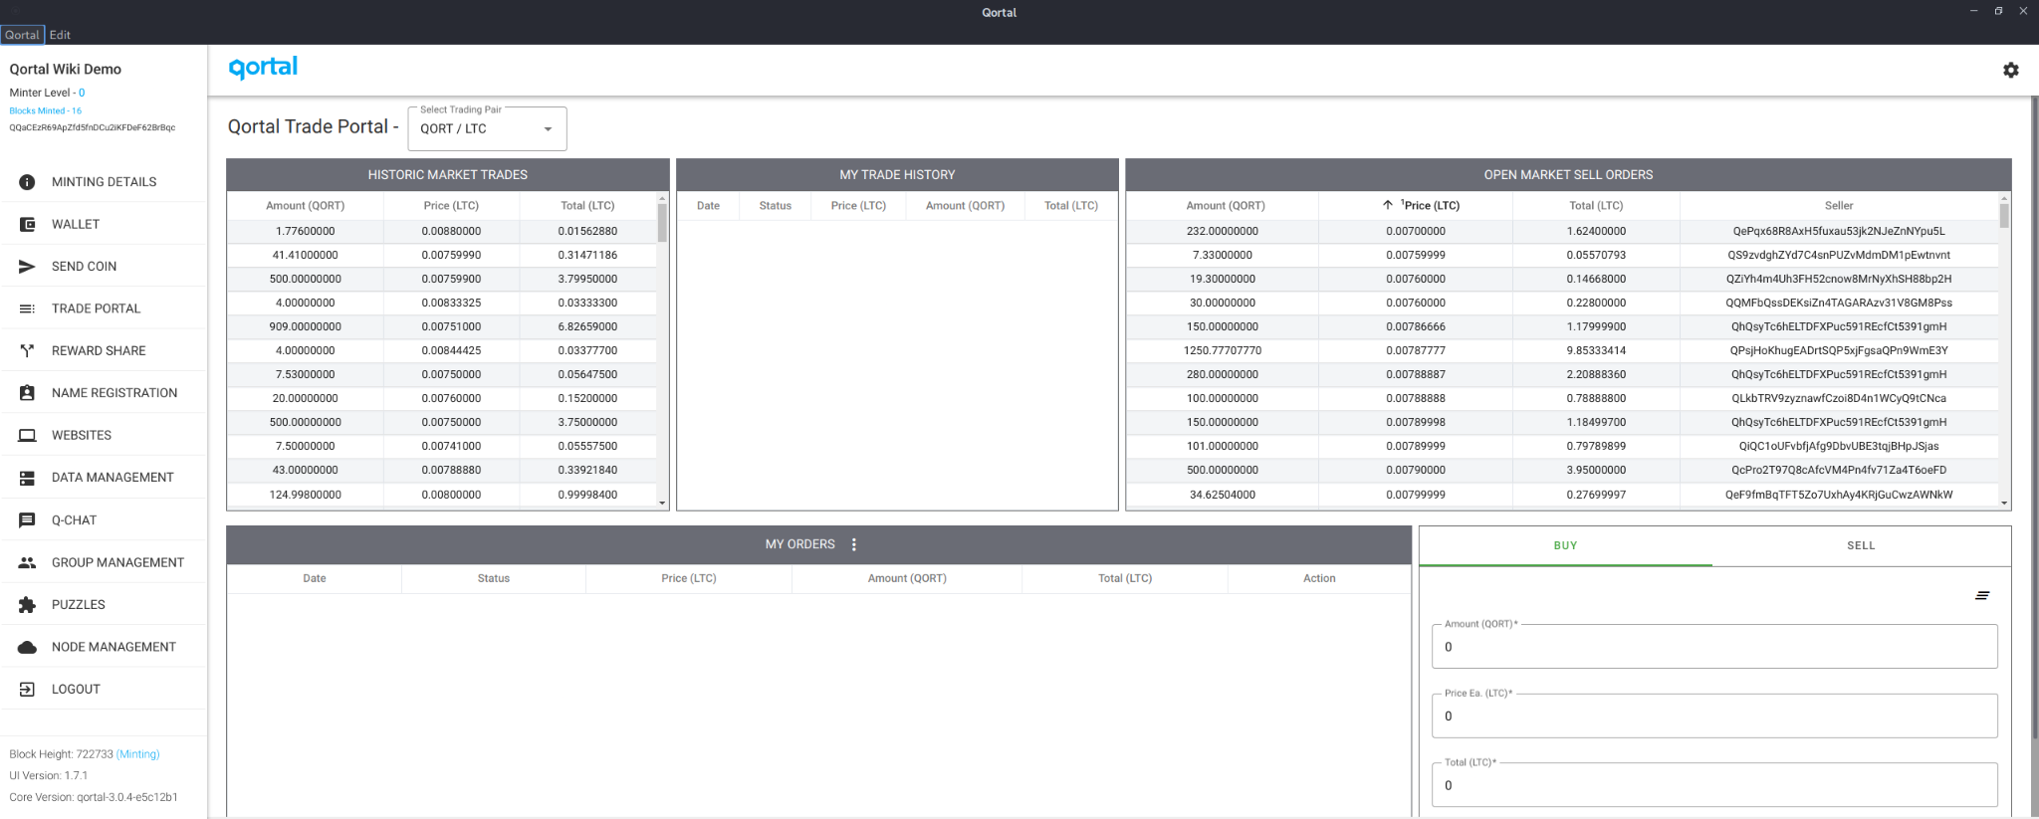
Trade Portal

Slide 49
Qortal Trade Portal
Qortal’s Trade Portal aims to remove the need for centralized exchanges and ‘decentralized exchanges’ which riddle the blockchain space with all sorts of flaws. That is not to say that all exchanges which claim to be decentralized are flawed, but surely most are. The idea of the Trade Portal is to provide true peer-to-peer (p2p) transactions between buyers and sellers without the need of a middle man by utilizing cross-chain trades in the form of ACCT (Atomic Cross-Chain Trades). The only authority over a trade taking place is solely between the buyer and seller!
The custom trade bot for the buyer and seller automates the multiple stages involved in a true cross-chain trade so that the Trade Portal is as simple to use as any centralized service but without any of the associated risks such as 1) historically these exchanges have been prone to hacks and failure, 2) depositing assets into a wallet or temporarily releasing control of assets during a trade, 3) any need for KYC/AML tools.

Slide 50
Qortal Trade Portal
The Trade Portal currently allows for cross-chain trades between QORT, BTC, LTC, DOGE, RVN, and DGB. Users never relinquish control of assets and never have to 'deposit' assets in order to make trades. This allows for complete security. Never again, will there be worry about centralized exchanges failing, and taking with that failure, users' assets.
As the development progresses, support for other assets will be implemented into the system. Voting will be the primary factor as far as which new assets will be added, however, a vote is not a guarantee of listing, as there will also be an independent verification done by the DevTeam to ensure only the most quality projects are listed in the Trade Portal.

Slide 51
Qortal Trade Portal
We believe minting is a superior system to existing proof of work (PoW) and proof of stake (PoS) systems. These systems allow people to buy their influence over the network. This is why the founding team wants to avoid supporting any PoS coins as these systems are a total conflict of interest to Qortal’s focus on egalitarianism. PoS systems allow you to run a single node and buy your influence over the network (block reward), in comparison to PoW where at least you are forced to run more nodes, and support the network by doing so, in order to buy your influence over the network (block reward).
With that said, we would like to support existing projects that meet our criteria, but it’s important to remember that we are building a new system, where new projects can be built with us and have their own tokens which will be in the Trade Portal. So there will be plenty of other cryptocurrencies supported by Qortal in due time as we collaborate with other projects.

Slide 52
Supported Coins/Tokens
To clarify, coins are assets on a stand-alone blockchain, such as Qortal’s coin and Ethereum’s coin. Tokens are assets built on other blockchains, such as ERC-20 tokens on Ethereum’s blockchain. Below is our criteria for supporting new assets on Qortal:
Truly decentralized.
No pre-mine (ICO/IEO/airdrops).
No Proof of Stake (PoS).
Unlikely to be delisted one day due to failing!
Keep in mind that there will be plenty of projects built on Qortal over time which will have their own token which will include wallets and markets in the Trade Portal.

Slide 53
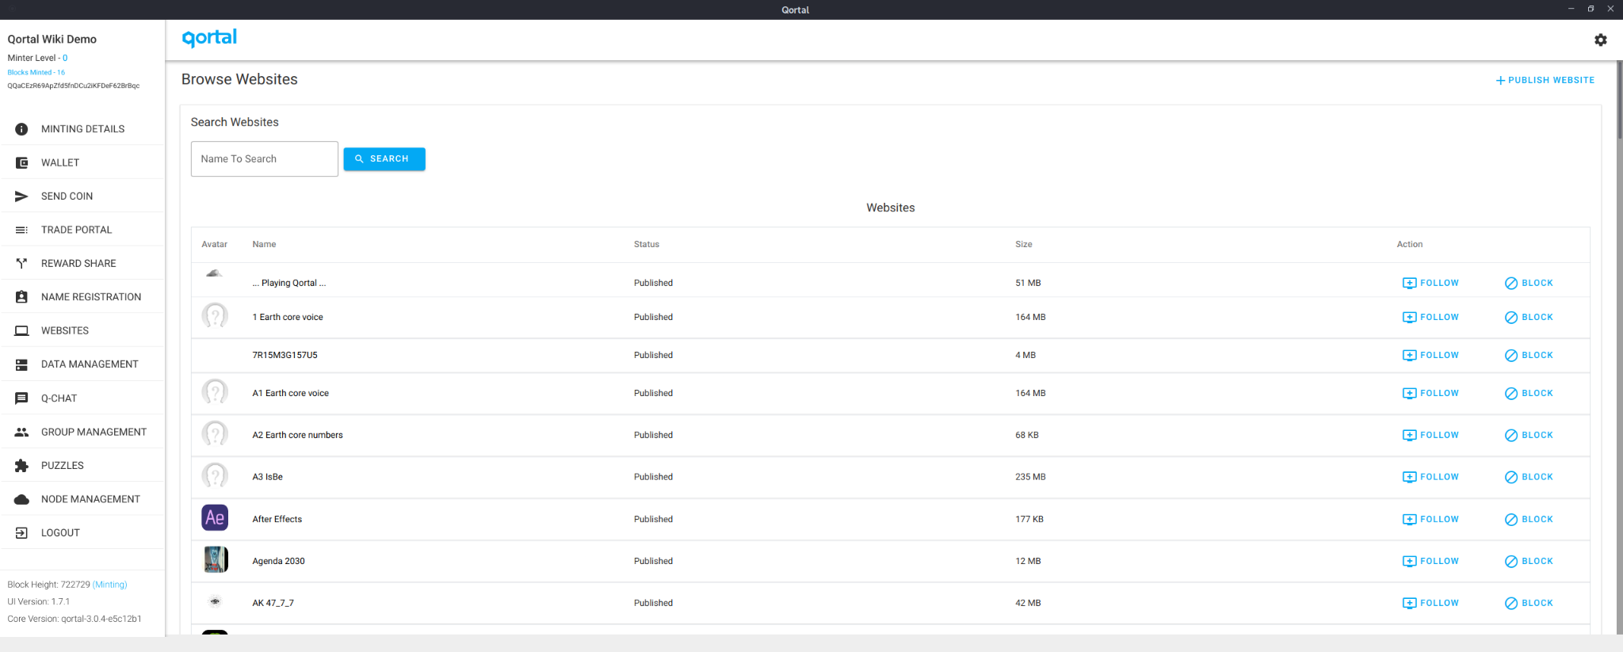
Qortal Data Network (QDN)

Slide 54
Qortal Data Network (QDN)
The Qortal Data Network (abbreviated as QDN) is LIVE! Currently, there is a data size limit of 500MB as we begin building this into a scalable solution to rebuild the Internet as we know it. The end-game goal is to have no limit on data hosting. This is an ambitious concept, so please bear with us! One of the main goals of the Qortal Project is to provide the world with a viable alternative to hosting websites and data that is free of any reliance on third-parties and is free of any censorship. Users do not have to be a minter or hold QORT to make use of this feature! Users can host their own website or data on their node, and other users can run redundant copies if they choose to. In the event that your node goes offline, the redundant copies keep your data live. Your data will be registered to your account on-chain, which means that only you will be able to change it - not those who run a copy for you.

Slide 55
How QDN Works
Save your website content to the computer you are using as a Qortal node.
Ensure the root directory has an index.html file, then create a zip of the folder.
Publish the zipped folder in the Qortal UI under the ‘websites’ plugin.
The chain will keep a hash of your data to credit your account with ownership so it cannot be edited by others (group ownership and editing will be possible in the future).
Others can choose to follow and run redundant copies of your data so the content stays live if your node goes offline.
Your site gets stronger, faster, more anonymous, and more redundant as more people view or follow your content.
Current limit is 500MB due to the multiple layers of building QDN from scratch, but the DevTeam is working to increase it; QDN is intended to be infinitely scalable in due time.
You can easily convert your WordPress site to Qortal as well as any HTML, JS, CSS static site. Dynamic sites are not supported at this time, however dynamic content will be something that will be developed in the future.
Notes:
Wait for g

Slide 56
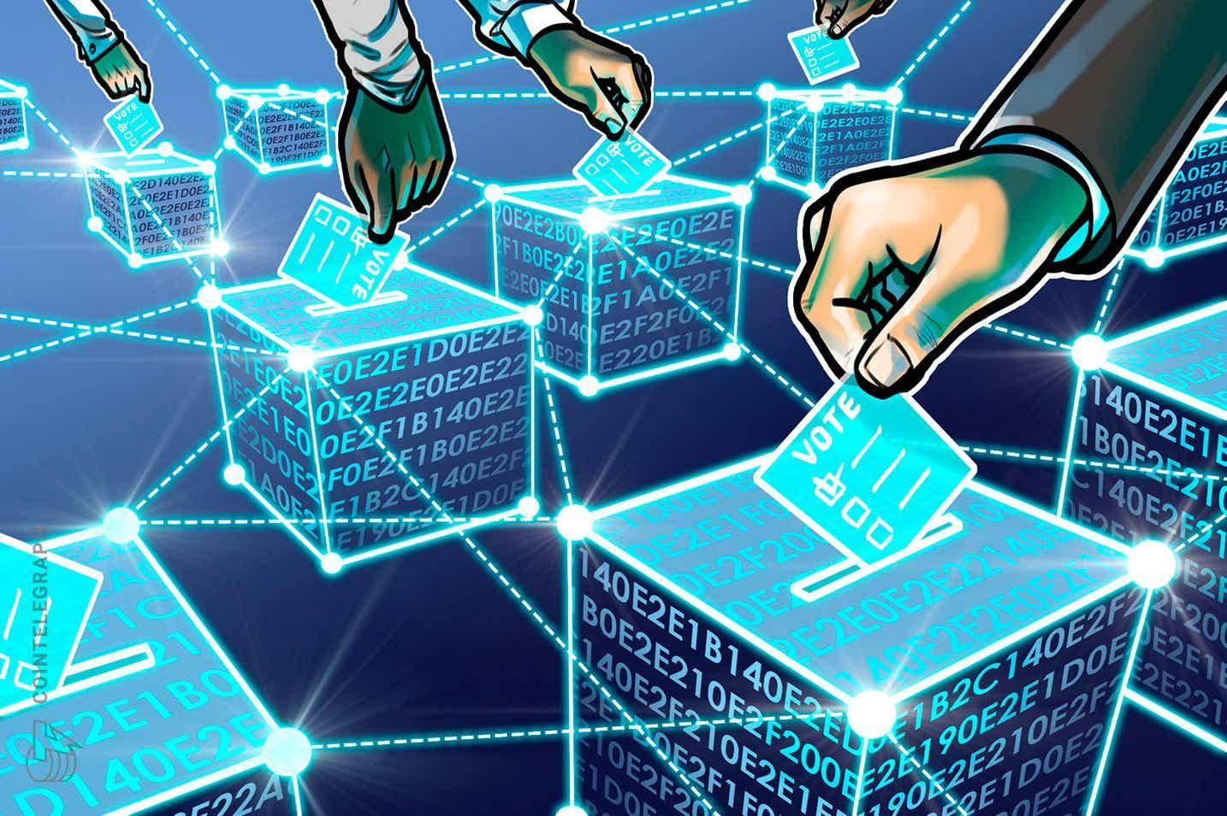
Voting System

Slide 57
Voting System
Qortal aims to create a true direct democracy where no outside government or party will have control. Instead, the people who contribute to Qortal by minting blocks will earn a weighted vote accordingly. Accounts will have a voting influence that is weighted based on the blocks minted count. For example, an account with 100 blocks minted would have more weighted influence than an account with 99. This is an extremely important concept as it is based on time and contribution.
The Founder accounts will have a different weighted vote that is based on their blocks minted count PLUS level 10 blocks minted count (this does change and is explained in the next slide). What we mean by this, for an account to reach level 10 requires 4,074,400 total blocks minted. So Founder accounts will have a weighted vote of 4,074,400 PLUS their actual blocks minted count. For a simple example, if a Founder has 100 blocks minted, the account would have a weighted influence of: 4,074,400 + 100 = 4,074,500

Slide 58
Voting System
When the first Founder reaches level 10, Founders will no longer have the boosted weighted vote as explained in the previous slide. Founders will then only have a weighted vote based on actual blocks minted. Also, those who were given pre-enabled levels as “QORA Forgers” will be given a 'blocksMintedPenalty' equal to the number of blocks they were credited with at Genesis. Yes, this could affect QORA Forger’s levels if they are on the cusp of reaching or had just reached a level. Refer to the Leveling System page on the wiki to see how blocks minted credit for levels 1-5 will not have too much of an impact on the QORA Forgers ,who should have high leveled accounts at the time of the ‘blocksMintedPenalty’.

Slide 59
Voting System
This penalty (just a technical term) is simply an effort to 'level the playing field'. This structure will incentivize users to keep their existing account minting, opposed to if we kept the previous concept where everyone would max out at level 10 which would incentivize users to begin a second account (since their original account is maxed out). This is the latest concept for building a fair system of egalitarianism. Subject to further modification.

Slide 60
Voting System
Please note: Qortal is ever evolving, as we build this from scratch.
Development does not always have room for the community’s involvement, although when possible, it certainly will be. The DevTeam Admins will always be the final decision maker of what is best, as they understand what is technically possible and what will make the most sense.
We realize that some folks might not fully grasp this circumstance, as ideologically we’d all love to be more involved. This is where we must respect and credit the team’s time and track record of building a fair system for all. One that is built with truly decentralized features that meet the foundational goal of egalitarianism and other fundamental principles.

Slide 61
Voting System
Voting will be used to help steer the project’s direction when applicable. Rather than leaving everything up to the DevTeam, the community will be able to vote on certain matters with how the DevTeam should allocate their time with options presented to the community. Such as which coins or features to implement next, or certain modifications needing to take place and which options the community thinks are the best ones to pursue.
There will NEVER be any voting for sanctioning or censoring as this will never be a possible action by the Dev Team! In the case of the Voting System itself, there does not seem to be any alternative solutions that could be presented as ‘options’ to vote on. This is a small example of how the DevTeam has to make decisions on behalf of the community, and the track record of building a system with genuine intention, deserves credit and a certain level of trust. We must remember that we are building infrastructure with trust-less features. It's important to separate the terminology and understanding of “trust” we have in our DevTeam versus the trust-less features built on-chain.

Slide 62
Voting System
Voting will also be used for the community to help approve new developers as an “Admin” of the DevTeam. What this means is that we have two types of DevTeam members: 1) anyone can join the team and help develop the codebase who DO NOT have the ability to vote on the 60% approval to push updates to the chain, and 2) DevTeam Admins who DO have the ability to vote on the 60% approval to push updates to the chain. The DevTeam would notify the community of the vetted developers being entered into a community vote, then the community will vote to approve the DevTeam Admins to push the update with their 60% approval. This update will then assign the “Admin” permission to the vetted dev’s Qortal account and it's official.
It is extremely important to have this layer of security with these two types of DevTeam members as the DevTeam Admins will be the only ones who can vote for a 60% approval to push updates. This creates a way for the community to have a say in who becomes a DevTeam Admin, and the DevTeam Admins keep the rest of the DevTeam in check as DevTeam Admins are the only devs who can push the 60% approval updates to the chain.

Slide 63
Voting System
The community will NOT be voting to directly approve code updates. There's no sense in having the community vote on what they cannot read and understand (code). Especially when they have not vested the time contributing to the codebase as the DevTeam does.
Otherwise let us know and join the DevTeam, and one day based on time and contribution, you may be vetted and cast in a vote to earn the Admin permission and take part in the 60% approval.
Notes:
Slide similar to 64

Slide 64
Voting System
The community will always be able to submit proposals and vote on them. This can be done by anyone. If they are approved by the community vote, they will get passed on to the DevTeam for review and to determine what is actually possible. The DevTeam will make changes to the concept if necessary, then submit a final approval for the community to vote on.
Thereafter, the DevTeam will move forward with development of the concept. Of course at any time, anyone is able to submit pull requests. That will always remain an option and has nothing to do with the Voting System.
The Voting System is expected to be implemented soon!

Slide 65
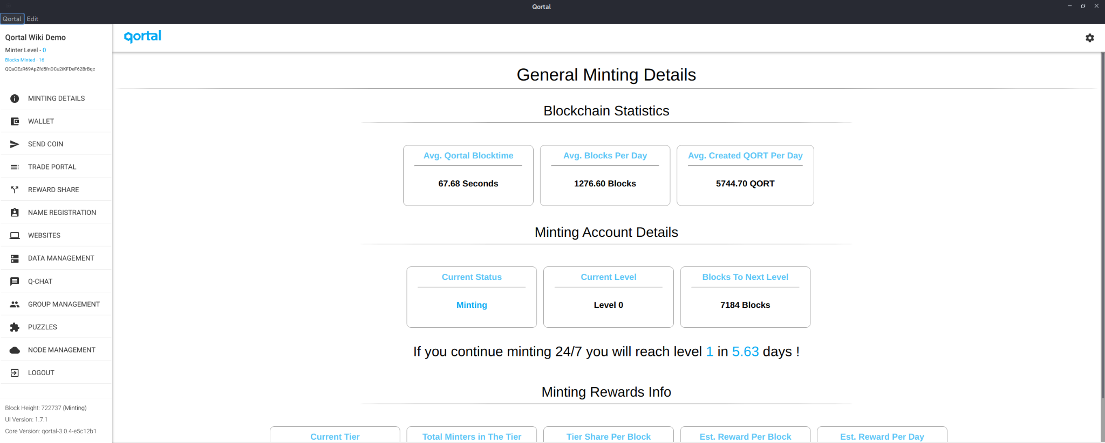
Minting Account Levels

Slide 66
Minting Account Levels
As a minter, you will 'level up' your account as you continue to prove yourself a supporting node on the network, and increase the count of your 'online blocks' therein. Leveling up gives you a couple advantages:
You will earn more in terms of rewards as you level up
Once reaching Level 5, you can begin to 'sponsor' other newcomers
Minters can assign their minting key to multiple nodes for redundancy. You will not earn ‘more coin’ or ‘double up’ but you will ensure your account is minting blocks in the event one of your nodes isn’t performing correctly.

Slide 67
Minting Account Levels
The following shows the amount of blocks needed from one level to the next. These are NOT CUMULATIVE and must be accomplished EACH LEVEL:
Level 0 to 1: 7,200‬‬ blocks
Level 1 to 2: ‭64,800‬‬ blocks
Level 2 to 3: 129,600 blocks
Level 3 to 4: 172,800 blocks
Level 4 to 5: 244,000 blocks (approximately 14 months from Level 1)
Level 5 to 6: 345,600 blocks
Level 6 to 7: 518,400‬ blocks
Level 7 to 8: 691,200 blocks
Level 8 to 9: 864,000 blocks
Level 9 to 10 (max level): 1,036,800 blocks (approximately 7 years 9 months from Level 1)

Slide 68
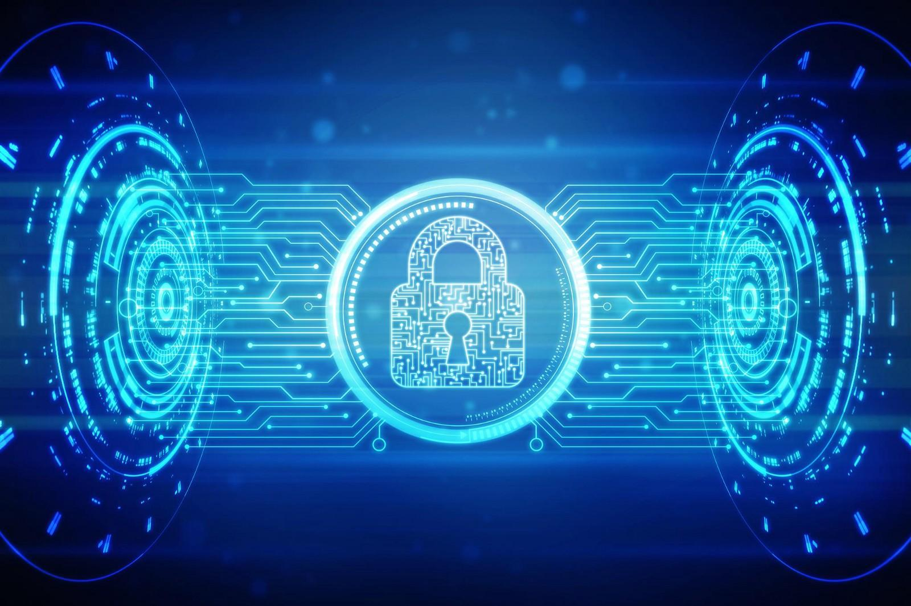
State-Of-The-Art Security

Slide 69
State-Of-The-Art Security
One of the main differences between the traditional Internet and Qortal overall, is the fact that there is no centralized authentication system, but at the same time, there is a system that can authenticate users that isn’t controlled by any one user or group. This opens the door for many different things to take place in a much more secure fashion. Another difference is the fact that all information that can be used to authenticate a user to an account is always encrypted when saved.
There are two entirely separate encryption engines in Qortal: the Core and the User Interface (UI). The Core can verify the transaction created by the UI and ensure it was created correctly, but the Core doesn’t need the information that created the transaction. Traditional systems contain a database of username/password information that could be hacked. Qortal does not have a database of information, it merely allows transactions to be created, signed, and submitted as long as the user contains the keys necessary to do so. Therefore, there is NO DATABASE OF USER INFO TO HACK.

Slide 70
State-Of-The-Art Security
Qortal’s security when compared to credit cards, is a perfect example. If you lose your card, any other person could make use of it since the information to use the account is printed on the card. This is no security at all! So credit card companies often have to rely upon ‘fraud prevention’ and ‘refunds’ to people since they experience countless fraudulent transactions daily.
In Qortal, it simply isn’t possible for any other user to access an account, unless the creator of the account gives the other user the passphrase to decrypt their locally saved backup information. Qortal’s security system is as simple as that, it just isn’t possible to access another user’s account without the account owner providing the information to do so.

Slide 71
State-Of-The-Art Security
Now if we take the same method of security used for the accounting side of Qortal, and apply it to on-chain services within Qortal, Qortal now provides secure infrastructure that can rebuild nearly everything that exists today, such as applications, websites, social media, communications, etc. On top of that, is the ability to utilize the verification system of Qortal - to verify other applications.
Therefore, Qortal can make its own or host a third-party application securely, while at the same time not requiring users to need individual username/password combinations for each application.
In other words, once the users verify with Qortal, they are verified for any application that utilizes Qortal!

Slide 72
State-Of-The-Art Security
Qortal can become a global authentication system so users never need to remember a bunch of user/password combinations again. This level of security and ease-of-use has yet to be seen in the world. Taking the method Qortal uses for verification and applying it to other avenues is the overall goal of Qortal. Blockchains are by far the most secure databases in the world, and the methods Qortal uses are more secure than most blockchains. Therefore, making use of this security at the base level of Qortal and taking it to other aspects of the world’s needs is the overall goal.
For example, Qortal can utilize its security for web hosting and data storage. Data that is put up is verified by the users account and can only be changed by the user. It’s truly as simple as that. Any other method will not allow the data to be changed so the account that created the data is the only account that can modify it. Continuing to utilize these methods and improving them in the Qortal Network will allow a truly secure infrastructure that the future world may utilize to bring back security and individual sovereignty worldwide.

Slide 73
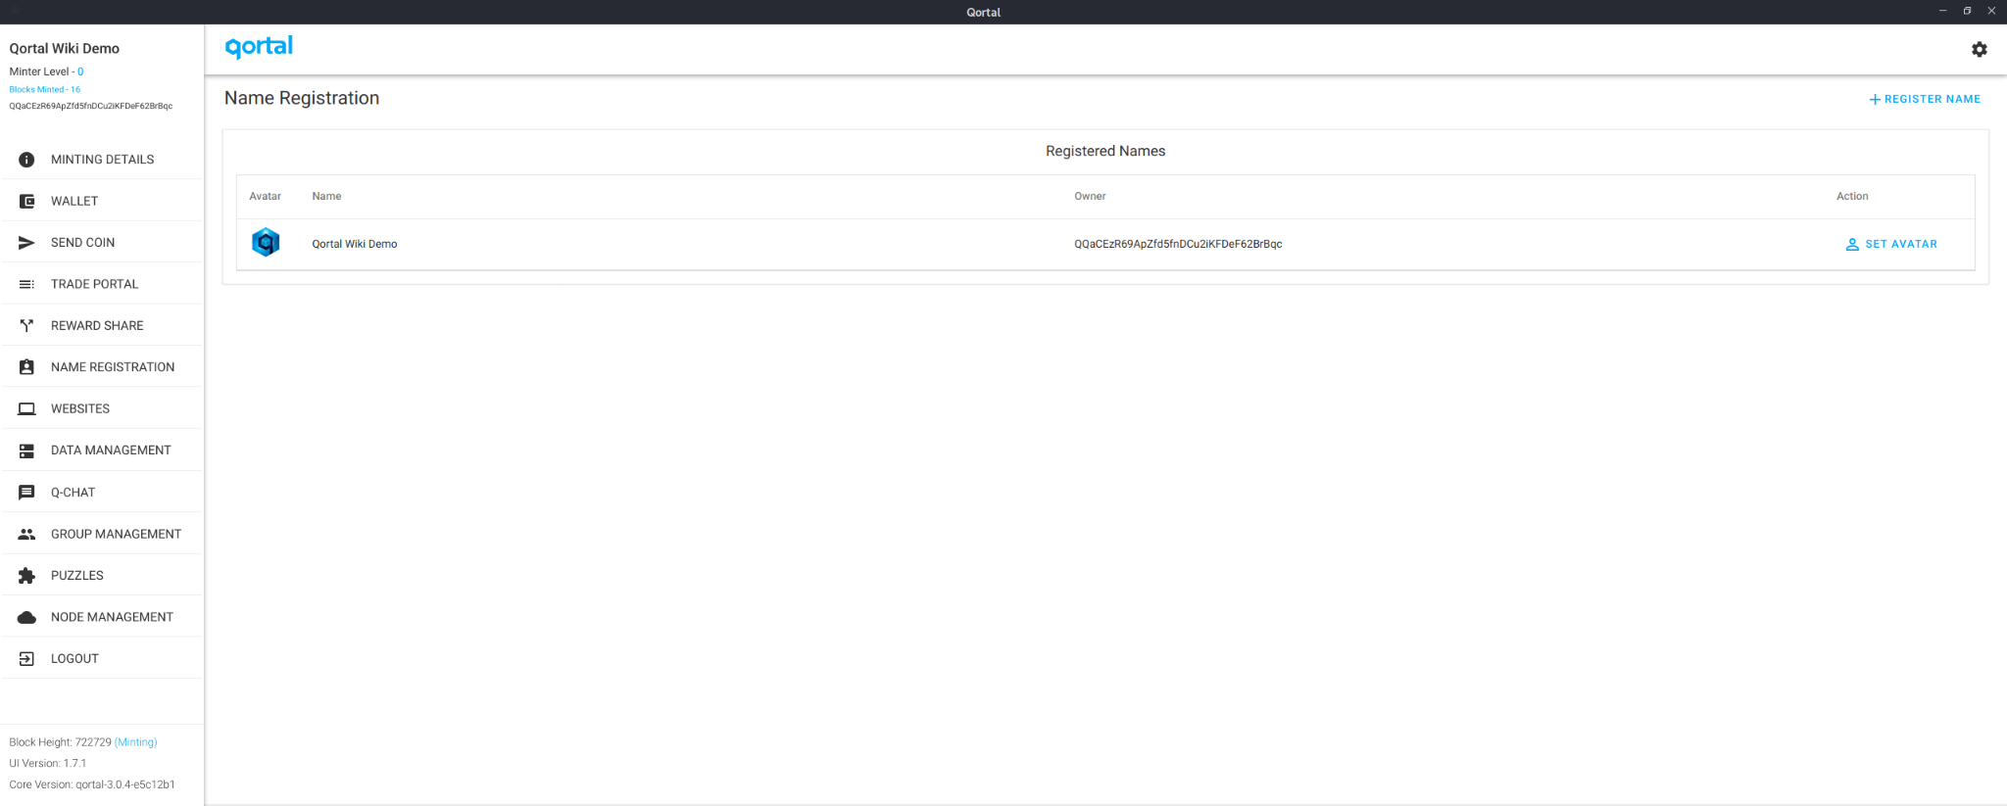
Name Registration

Slide 74
Name Registration
In Qortal, when a user registers a name they then own that name. The user created that name and that name is completely unique. This alone opens the door for many eventual use cases such as ‘trademarks’ and any other type of ‘name ownership’ that must be ‘proven to be owned’. If a user registered the name, they own that name until they decide to sell it in the ‘names market’ which will be made active in the future.
Names on Qortal can be utilized as usernames for various applications such as Qortal’s own ‘Q-Chat’ wherein the user’s name will show up as the one sending messages and can be used by others to send messages to the user (as opposed to the wallet address). Any number of other applications that would prefer using a name instead of a long string of random digits to identify a user could make use of name registration for that purpose.

Slide 75
Name Registration
Name registration also ties the registered name to an address in Qortal and can be used to send coins or message on Q-Chat. Instead of having to remember a long string of digits or enter a long wallet address every time a transaction is needed, simply input the registered name. It will then be converted to the associated address automatically and sent to the correct address. This takes much of the perceived complexity out of utilizing blockchain-based systems.
Registering a name in Qortal currently costs a flat fee of 1.25 QORT (in the future this number may be modified) and after being paid, the name is owned by the account forever. There is no continual fee associated with name registration. The ability to sell names to other users in the ‘names market’ will be possible in the future (the functionality is already built, the user interface just needs to be built to make the actual market visible and easy to use).
When the names market exists, users will be able to sell their registered name to another user in a similar fashion to that which the Domain Name System currently uses.

Slide 76
Name Registration
With web hosting and data storage, a major use case for name registration will be that of ‘domain names’ on Qortal (these are not called domain names, they are simply ‘names’ tied to a data space). These names can be utilized by any user of Qortal to access data hosted on a name’s data space. This could be a website, blog, social media page, or essentially anything the user chooses to put on the data space. An application utilizing the data space could also be built and any other user could then access the application utilizing the name.
A ‘proxy’ setup with a Qortal Node could be utilized for those wishing to use a Qortal name to host a site that will also be accessible through a traditional Domain Name. The Qortal node would act as a proxy, proxying the access of a domain name, to the Qortal Network, and the registered name there. This would allow data hosted on the Qortal Network to be accessible without the need for installation of a Qortal node in order to access the data - giving access to anyone with the click of a link.

Slide 77
Q-Apps

Slide 78
Q-Apps
Q-Apps will be our app center where any number of applications can be built on the Qortal Data Network (QDN) when it goes live. Everyone needs to remember to USE AT YOUR OWN RISK. We will have a star rating review and comments section as any app store would have but we can't expect the DevTeam to review and vet each application - even though we will try our best!
Every application built on the Q-Apps will be by default ‘unhackable’, decentralized, and redundant (more-so as each user accesses the application). The underlying functionality of the Qortal Data Network allows for extremely secure applications with endless possibilities.
Remember that Qortal is infrastructure and meant to be the base level for any potential application to be used by people on a regular basis. Therefore the Qortal development team is focused on building the infrastructure and a few base level applications to demo what the platform can do. The rest of the applications and functionality within will be developed by whoever has the idea and takes on the task.

Slide 79
Q-Apps
Two main types of applications will exist: 1) default applications and 2) add-on applications. Default applications will come with the default installation of the software and will be ‘part of Qortal’ by default.
These applications include some of which already exist like Q-Chat and the Trade Portal. Default applications are the ones that will ‘just be there’. Add-on applications (plugins and modules) are applications that will not be included by default when installing Qortal, but can be chosen to ‘opt-in’ by each user to be installed on their node.
Qortal is the only blockchain platform that has both the ‘data layer’ and the ‘application layer’ making it an all-in-one solution for hosting any application with blockchain security and true decentralization.

Slide 80
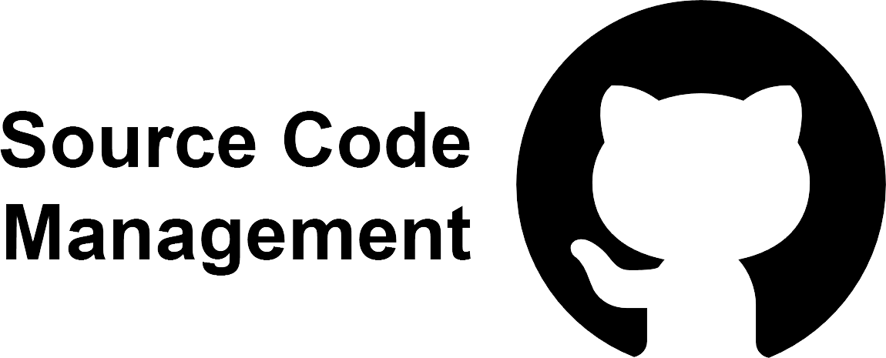
GitHub Replacement

Slide 81
GitHub Replacement
Now that the Qortal Data Network (QDN) exists, one of the first ‘applications’ planned to be built will be a GitHub replacement. For those who are not aware, ‘github.com’ is the main code repository location for most open source applications. GitHub was recently purchased by Microsoft which was a very worrying fact for a lot of people. Since GitHub is a centralized server, anything on that server could potentially be removed by Microsoft and this could cause issues for those hosting their code repositories on GitHub.
‘Git’ is the program that GitHub uses to keep track of the code and its changes. It is a decentralized application and does not require a centralized server in order to function. The only part of git that is centralized at the moment, is the GitHub repository server itself. All that needs to be removed in order to make a completely decentralized GitHub replacement, is the storage location of the code repositories. Therefore, a location to store git repositories on top of Qortal is essential to making a secure, decentralized option for open source applications.

Slide 82
GitHub Replacement
The initial concept will be to utilize the ‘Qortal git’ to store the Qortal codebase itself, however, in the near future that functionality will be able to be expanded to allow anyone to use the Qortal git to store their open source code repository.
At this point, Qortal will have a complete replacement for GitHub without any centralized authority or associated costs. Hosting an application’s code repository on top of a decentralized data storage platform like Qortal alleviates countless concerns surrounding a centralized code repository. There will no longer be ‘downtime’ and there will be no potential for ‘censorship’ of any kind including removal of code from repositories that do not fit within whatever rules the centralized owner of the repository server may have.
Qortal will provide complete freedom of open source software applications and storage of their codebase in a free and easy to distribute new system. Any code repository that obtains a data node follower will obtain another redundant copy of the repository (just as the website hosting of QDN functions now).

Slide 83
Third-Party Minting Projects On Qortal

Slide 84
Third-Party Minting Projects On Qortal
Qortal will provide a superior alternative to blockchain platforms such as Ethereum where projects can build on these chains and issue token rewards for mining their project. In the case of Qortal, we refuse to be a Wild West where scam projects run rampant, so there will be a screening and vetting process for projects to have asset issuance (their own token). The DevTeam will review proposals of prospected projects, then write a summary as to why the DevTeam is vetting for the project. The community will review the summary and then cast their vote to approve the project, which will give the DevTeam Admins permission to conduct their 60% approval vote, and the asset issuance permission will be assigned to the project.
These tokens will be available in the Trade Portal once the project has launched and sell orders are placed! This is why we stress the importance of carefully choosing what coins to support in the Trade Portal now, as eventually we’ll have projects built on Qortal that will be added to the Trade Portal.
The Voting System has not been launched at this time, so approving new projects to have asset issuance won’t be an option until then.

Slide 85
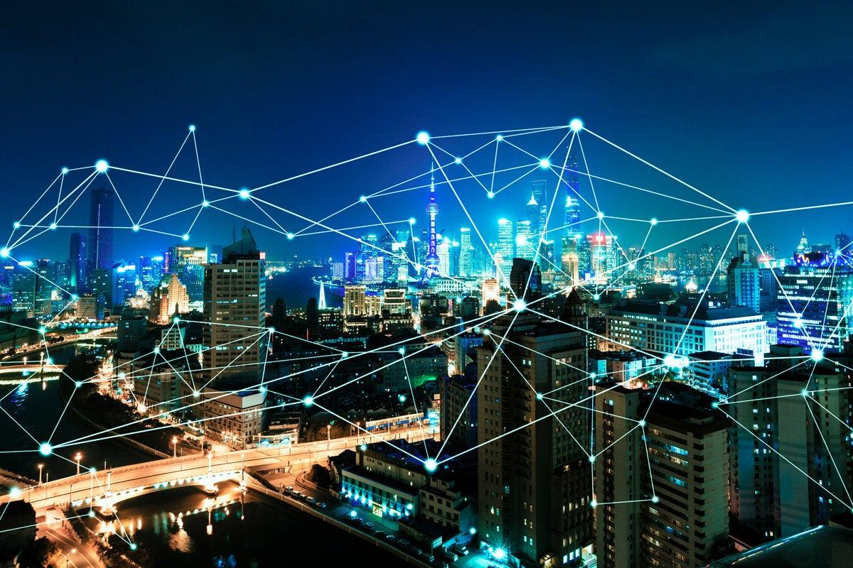
Mesh Networking

Slide 86
Mesh Networking
The Mesh Networking concept will replace more ‘traditional’ service methods once the network of Qortal nodes is large enough. This means that the Qortal Network must grow to a point where there is another Qortal Node within a reasonable distance for wireless connectivity, or to the point that there are enough Qortal satellites to bridge all ‘gaps’. This must be accomplished prior to mesh networking for it to be a feasible option to fully replace existing internet service providers (ISPs). However, utilizing mesh networking while the network is still growing is also possible and will be how the overall concept comes to fruition.

Slide 87
Mesh Networking
In order to begin constructing the network that will eventually be able to replace internet service providers (ISPs), there will be multiple smaller mesh networks built in various locations (with nodes who are within distance of one another) that then utilize at least one ‘gateway’ to the traditional Internet to ‘bridge the gap’. Multiple mesh network enabled ‘sub-communities’ (who may share a single internet gateway or share multiple) will be created around the world. These communities will connect to one another with Qortal’s mesh network technology and to the rest of the world over their existing internet connections. Something unique about this concept is that those who are connected to the Qortal Mesh Network could ‘share’ the internet connection of the others in the sub-community to facilitate the remaining communications needed outside of their local network.

Slide 88
Mesh Networking
A sub-community could be a neighborhood for example (consisting of x number of houses) and could decide to connect together utilizing the Qortal Mesh Network. Once they have established the local mesh network, they could then decide for two of them to retain their internet connections to be used as ‘gateways’, and the rest could decide to terminate their internet service. They could then split the costs of the remaining two connections between them. Not only would this allow everyone in the sub-community to pay much less for their connections, it would also allow everyone in the sub-community to have redundant internet connections (if one of them goes down, the other will take over). Ideally the two connections would be of two different ‘types’ (one DSL connection and one fiber connection, or any two different connection types) so that if there was an issue with the cable service in the area, it wouldn’t take down both connections used as gateways.

Slide 89
Mesh Networking
Once the Qortal Network is large enough and there are enough mesh network enabled nodes to do so (including enough Qortal Satellites to alleviate the need for ISPs) the Qortal Mesh Network will completely replace the current methods in which people digitally connect to one another. There will no longer be ‘internet service fees’ required to connect worldwide. Simply run a Qortal node and have a device with wireless connection technology to then have a free internet connection to the rest of the world. This is our concept so far, and we strive to make this happen soon!

Slide 90
Decentralization Has Trade-Offs

Slide 91
Decentralization Has Trade-Offs
Qortal is a very ambitious project with a focus on individual sovereignty so that we can regain control over our digital lives. Unhackable infrastructure like this can help the world come together like never before! We believe in building a truly decentralized platform that is free of any regulation other than by the codebase itself.
Of course true decentralization comes at cost. It will allow for illicit activity to run rampant, but with individual sovereignty comes individual responsibility. Data processed by your node is encrypted and chunks of QDN data is relayed between nodes. The data does not come from a single node, so there should be no concern of supporting illicit activity on a technical level. Users can turn off the relay mode feature at any time if the lack of confidence of this feature is too concerning.
We also have plans to obscure IP addresses and implement more privacy features soon, the future is bright and empowering. Qortal currently and always will have no KYC (know your customer). We respect anonymity and have plans to further enhance this aspect.

Slide 92
How Can You Help?
Run a node and support the network.
Spread the word to others you know.
Share your ideas with the community.
Study the wiki! When in doubt, did you check the wiki out?
Help answer questions in the chat channels as you learn more.
Find us developers: Core is written in Java, UI is written mostly in JavaScript.
If you know any influencers ask them to speak with us.
Share our project on social media.
If you have any ideas for funding this project, please reach out to us.

Slide 93
How To Get Started

Slide 94
How To Get Started
First you’ll need to set up a node, as Qortal is truly decentralized which means you’ll need a node to communicate with other nodes. This is, of course, how decentralized blockchain technology works. You are in complete control over your node, your account, and your destiny.
As mentioned earlier, you can set up a node on virtually any existing computer - whether it’s a Linux, Windows, or Mac OS. You could also build your own Raspberry Pi or buy one pre-built at www.crowetic.com. You could also set up a node on a VPS which is a virtual computer you rent from a company, but this is not recommended as we want you to be in complete control over your node, although you certainly can set up a VPS and several of our community members do now.
For additional information go to the wiki and scroll down the menu to the ‘Node Setup Guides’ section to select the walkthrough guide for your node type.

Slide 95
How To Get Started
The Qortal Wiki is a repository of information related to Qortal. When in doubt, did you check the wiki out? The goal is for everyone to be able to easily find information on the wiki rather than ask obvious questions in the chat systems.
We would appreciate it if you would take the time to study the available content. It’s the coolest homework assignment you’ll ever have!
We realize that the wiki may not have everything you are looking for, but we are constantly working to improve it. Please watch the following video so you can have a better idea of how the wiki is structured.

Slide 96
Qortal Wiki

Slide 97
IMPORTANT INFORMATION!

Slide 98
Account Setup & Recovery
Please be sure to setup and backup your Qortal account properly! We cover this on the wiki with a walkthrough page and video titled “Account Setup & Recovery”.
You can recover your account by using the seed phrase or backup file.
We do NOT recommend using your seed phrase as your backup file is all you need. It will also ensure you log into the correct account.
If you enter your seed phrase incorrectly, the blockchain will NOT tell you that you have logged into the wrong account. You might not even notice it is the wrong account as a newcomer. We have seen this before!
Be sure to write down your public key, address, and store your backup file!
Remember, it is safe to share your public key and address.
NEVER share your seed phrase!
Please watch the following video.

Slide 99
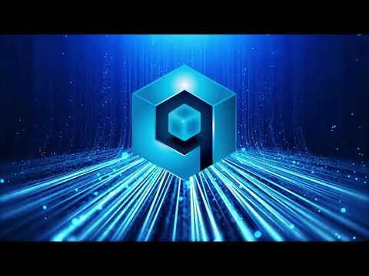
Account Setup & Recovery

Slide 100
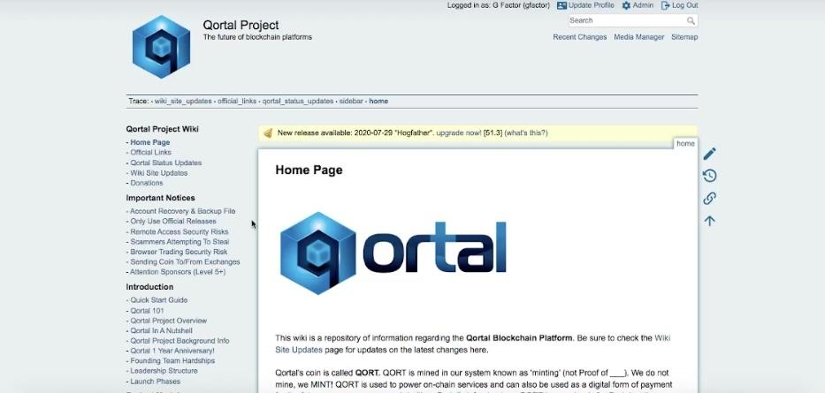
Account Setup & Recovery
Again, we cover this on the wiki with a walkthrough page and video titled “Account Setup & Recovery”. Simply watch the video on the homepage and we’ll point out where this page is located!

Slide 101
MORE IMPORTANT INFORMATION!

Slide 102
MORE IMPORTANT INFORMATION
Only use official releases, otherwise USE AT YOUR OWN RISK. Your node will auto update the core and UI. We have had one auto update failure so it can happen, but when in doubt, please ask!
Once Q-Apps is live, USE AT YOUR OWN RISK. We cannot audit and vet everything built on Qortal, and we cannot sanction or remove apps.
DO NOT LET OTHERS GAIN REMOTE ACCESS TO YOUR DEVICE. Such as for tech support. We should be able to assist you in the official tech support channels and/or refer you to the wiki page for official guidance.
If you choose to remote into your node from another device, do so on your own networks - NOT PUBLIC WIFI for security reasons.
We will NEVER ask for money in private messages, there are scammers who will pose as us and attempt to scam the community.
BE CAREFUL CLICKING LINKS FROM PEOPLE YOU DON’T KNOW. A simple click of a link could be all it takes to gain access to your computer!

Slide 103
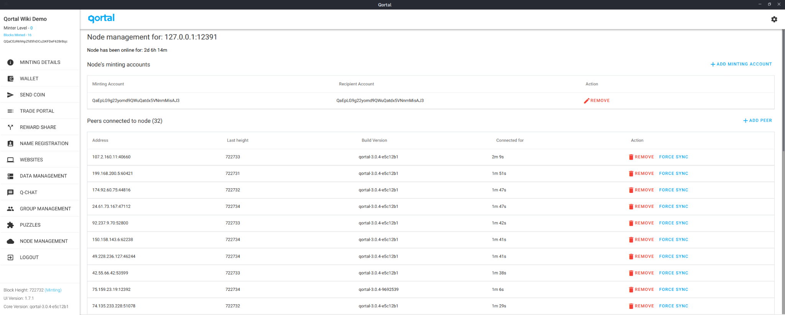
Becoming A Minter

Slide 104
Becoming A Minter
Remember, you do NOT have to be a minter to use all of the other features on Qortal, such as Q-Chat, hosting your own website/data, or building an application on Q-Apps (coming soon). For those interested in becoming a minter and supporting the network, after you’ve set up a node and are fully synchronized, you can then seek sponsorship by simply introducing yourself to the community and asking for sponsorship.
Sponsors are free to set their own criteria, although Qortal is meant to respect anonymity, so sponsors should not be asking for personal information. There are plenty of people who will happily sponsor, although keep in mind that level 5+ accounts are only able to sponsor 2 accounts at a time (and 5 at a time for each Founder), so sponsorship may not happen immediately. Please keep in mind we are building infrastructure for a lifetime, even to outlive us all, so please be patient.

Slide 105
Becoming A Minter
The minting and sponsorship system is our way of preventing mining farms, and building a network of nodes by real people. Of course with no KYC we cannot guarantee one minting node per person, and honor systems are always taken advantage of, but we still believe this is a more superior system to existing PoW and PoS systems. Egalitarianism is the goal and we will be making modifications to the system to combat gaming as best we can. Ultimately the codebase must govern in a network-wide manner - sanctioning autonomously based on data and defined rules. What we do NOT want, is a system where we single out accounts manually and create a window of vulnerability to gang up on others, therefore compromising true decentralization.

Slide 106
Minting Overview

Slide 107
Minting Overview
Again, we do not MINE, we MINT! Minters earn a portion of each block reward for every block they help process.
You do not have to hold QORT to mint, and your QORT balance will not make any difference to your block reward. As we went over earlier, your account level tier is what will determine how much QORT you earn each block, which is based on how many minters are in your tier and minting each block.
To become a minter, you need to be sponsored. You will send your public key to your sponsor, who will then generate your Reward Share key which you will enter in Node Management. At this point you are level 0 and will mint the first 7200 blocks to reach level 1. This is a period where you prove yourself a working node to the Network. If your node stops minting for whatever reason, you will NOT lose credit for the blocks you’ve minted so far, you will simply pick up where you left off. Although with this said, please keep an eye on your node as if your node isn’t minting, it delays sponsors being able to sponsor the next sponsee, and a sponsor may deactivate your reward share momentarily to sponsor someone else, then recreate your reward share when your node is ready to go.

Slide 108
Minting Overview
Once you reach level 1, you will remove the sponsor’s reward share key from Node Management and create your own reward share key with your public key. You will then enter this reward share key in Node Management. Once you have done so, you will now earn block rewards for every block your node helps process.
Sponsors appreciate when the sponsee notifies the sponsor of reaching level 1, so that they can remove the reward share on their end, and begin sponsoring the next sponsee in line.
If you would like, you can add your reward share key to more than one node, which will give your account better redundancy, meaning your nodes will work together to help process blocks. You will NOT earn additional rewards for doing so. Some of us run nodes in different locations, such as at a family member’s or friend’s house so IF in the event the power, internet, or node goes down at home, we still have another node minting elsewhere.
Once you reach level 5, you will be able to help sponsor newcomers who are seeking to become a minter.
Sponsors do NOT earn anything for sponsoring others. Let’s work together to grow the network of nodes! More nodes means more decentralization!

Slide 109
Sponsorship Questionnaire
It would be nice to see more sponsors use the sponsorship questionnaire available on the wiki, but again, each sponsor is able to set their own criteria as they choose.
The questionnaire is not meant to be a pass or fail situation, only a great way to gauge the current level of understanding the sponsee has and help clarify what is not understood.
At the very least, it makes a great conversation starter, but some sponsors are busy with other things so we have to take that into consideration. Let’s answer the questionnaire together…

Slide 110
Sponsorship Questionnaire
How did you hear about Qortal?
When did you join us?
What makes you want to join Qortal?
Do you have any ideas on how you can contribute?
What is Qortal? Qortal is infrastructure that utilizes blockchain technology with a focus on true decentralization. Qortal is not only infrastructure for a decentralized, censorship-free Internet… it is an entire decentralized operating system where virtually any ethical project/application can be built securely!
When did Qortal launch Genesis (block #1)? Qortal launched June 29th 2020. Crowetic took over the development of QORA in 2016. Some of the concepts of QORA began as far back as 2013. QORA’s codebase was not sufficient to build upon, it was decided that the codebase needed a complete rewrite - other than some snips of transaction code which even then are expanded upon. So rather than having a ‘QORA2’ and a separate trade portal called ‘Qortal’.. it was all merged into one as Qortal.
Notes:
Wait for g

Slide 111
Sponsorship Questionnaire
Is QORT a token or coin? What are the purpose(s) of QORT? QORT is a COIN. Not a token. As Qortal is it’s own chain, not a project on another chain such as projects are on Ethereum (which makes their asset a token). Coins are the chain’s native asset, such as is with QORT. QORT is both used to power on-chain functionality and can also be used as a digital form of payment on the new web we build where e-commerce and job markets can thrive.
Did Qortal have a pre-mine of QORT? No! We appreciate projects that do not pre-mine.
Once you are sponsored, how many ‘minted blocks’ does it take for your level 0 account to reach level 1? 7200 blocks.
Do you earn QORT during level 0? When do you begin earning block rewards? No. After reaching level 1 and assigning your new minting key to Node Management.
Does your sponsor earn anything for sponsoring you or others? No.
Do you have a node synced and ready to go prior to asking for sponsorship?
Do you have any questions?
Notes:
Wait for g

Slide 112
THANK YOU FOR YOUR TIME!
Keep in mind that the project is constantly evolving and will be modified as needed to maintain the integrity and security of the project.
Let’s be messengers who pass the message on to the next messenger!
Together we are the chain!

